Slide 1

Online Books Stores Project
By:- Ankit Rajak

Slide 2

Introduction:-
In the digital age, online book stores have revolutionized the way people purchase and access books. This project, titled "Online Book Store using PostgreSQL", is a web-based application designed to simplify the book buying process for users. It allows customers to browse, search, and purchase books conveniently from their homes.
The primary goal of this project is to build a reliable, user-friendly platform where both users and administrators can interact efficiently. PostgreSQL, a powerful open-source relational database system, is used to manage and store all the book-related data, user information, and transaction records in a secure and structured manner.

Slide 3
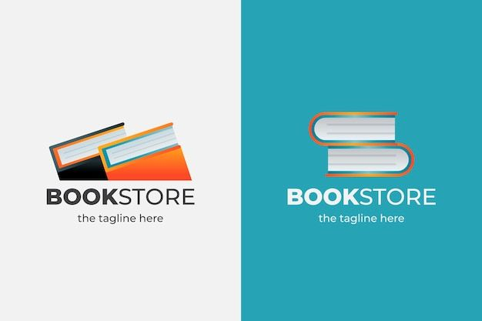
Basic Problem:-
1.RETRIEVE ALL BOOKS IN THE 'Fiction' GENRE ?
2.FIND BOOKS PUBLISHED AFTER THE YEAR 1950?
3.LIST ALL CUSTOMERS FROM THE CANADA?
4.SHOW ORDER PLACE IN NOVEMBER 2023?
5.RETRIEVE THE TOTAL STOCK OF BOOKS AVAILABLE?
6.FIND THE DETAILS OF THE MOST EXPENSIVE BOOK?
7. SHOW ALL CUSTOMERS WHO ORDERED MORE THAN 1 QUANTITY OF A BOOK?
8.RETRIEVE ALL ORDER WHERE THE TOTAL AMOUNT EXCEEDS $20?
9.LIST ALL GENRES AVAILABLE IN THE BOOKS TABLE?
10. FIND THE BOOK WITH THE LOWEST STOCK?
11. CALCULATE THE TOTAL REVENUE GENERATED FROM ALL ORDER?

Slide 4
ADVANCED QUESTIONS:-
1.RETRIEVE THE TOTAL NUMBER OF BOOKS SOLD FOR EACH GENRE?
2. FIND THE AVERAGE PRICE OF BOOKS IN THE 'Fantasy' GENRE?
3. LIST CUSTOMERS WHO HAVE PLACED AT LEAST 2 ORDERS?
4. FIND OUT MOST FREQUENTLY ORDERED BOOK?
5. 5.SHOW THE TOP 3 MOST EXPENSIVE BOOKS OF 'Fantasy' GENRE?
6. RETRIEVE THE TOTAL QUANTITY OF BOOKS SOLD BY EACH AUTHOR?
7. LIST THE CITIES WHERE CUSTOMERS WHO SPENT OVER $30 ARE LOCATED?
8. FIND THE CUSTOMER WHO SPENT THE MOST ON ORDERS:
9. CALCULATE THE STOCK REMAINING AFTER FULFILLING ALL ORDERS?

Slide 5

Conclusion:-
The Online Book Store project demonstrates how technology can streamline the process of buying and selling books through a convenient and efficient platform. By utilizing PostgreSQL as the backend database, the system ensures secure, fast, and reliable data management.
This project not only enhances the user's shopping experience but also simplifies inventory handling and order tracking for administrators. It bridges the gap between readers and sellers, promoting a smarter and digital reading culture.
Overall, this project serves as a foundation for building more advanced e-commerce systems in the future, with scope for further development such as payment gateway integration, book reviews, recommendation systems, and mobile app support.

Slide 6
THANK YOU

